Slide 1
Zombie distrubution
Vitor Barbosa 105248

Slide 2
First Person Shooter
Sobrevivência
Gerenciamento de recursos

Slide 3
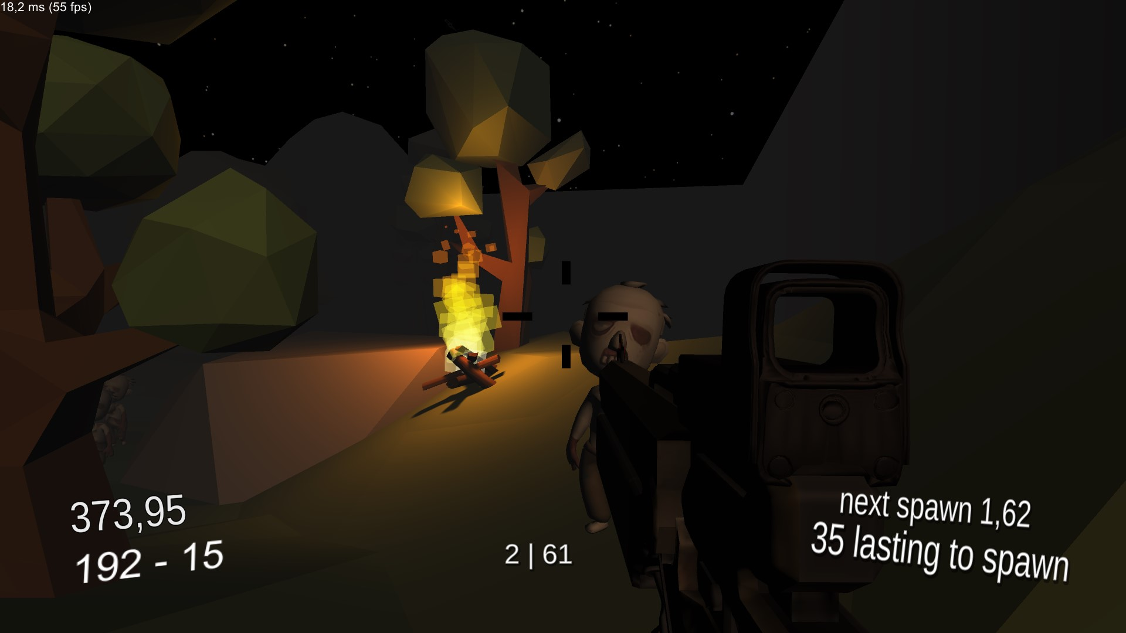
Tempo
Próximo surgimento
Eliminações | Total de inimigo
Munição
Inimigos para surgirem

Slide 4
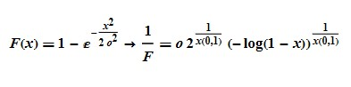
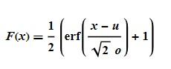
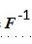
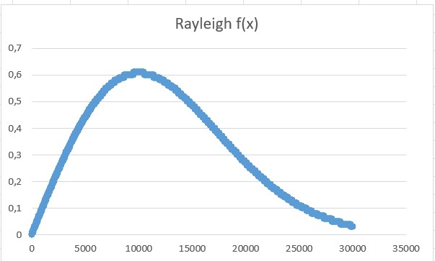
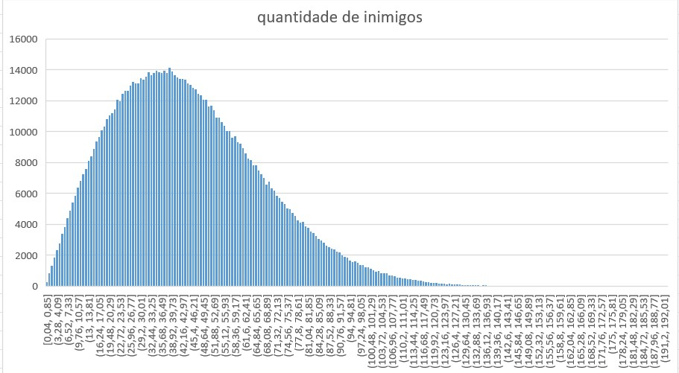
Total de inimigos
->
Distribuição de Rayleigh * 50
a=0
b=1 (σ= √2/2)
F(x)= 1-exp[(-x^2)/(2o^2))] ->F^(-1)=o√(-2ln(1-x), x[0,1]
double rayleighInv(double desv)
{
float s = -2 * Mathf.Log(1 - UnityEngine.Random.Range((0f), (1f)));
return desv * Mathf.Sqrt(s);
}

Slide 5
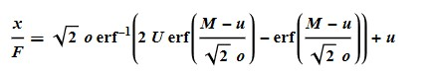
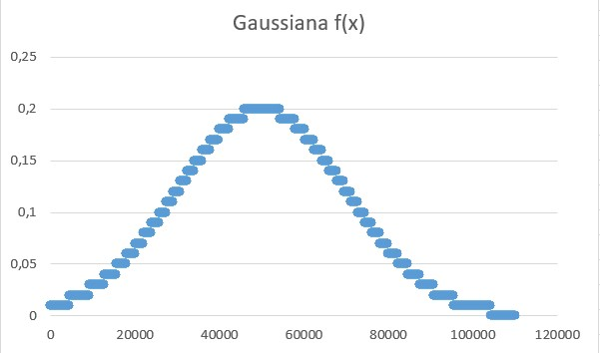
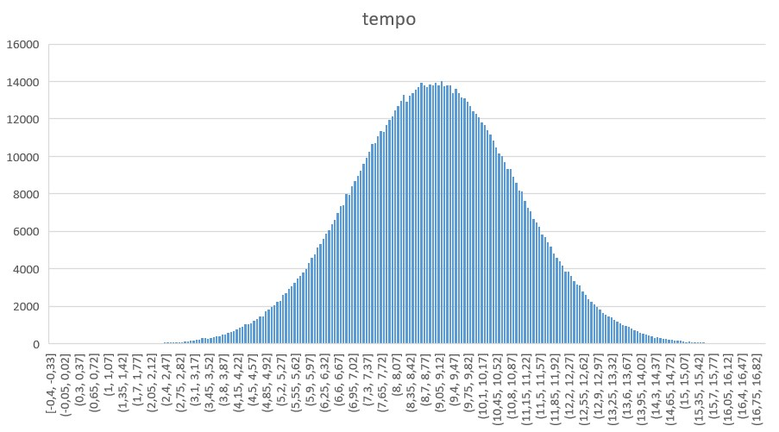
Tempo por inimigo
->
Distribuição de Normal
µ=9
σ=2
F(x)=(1/2)[1+erf((x-u)/(o√2))]
F^(-1)(x)=u+o√2*erf^(-1)((erf((M-u)/(o√2))+erf((M-u)/(o√2)))U-erf((M-u)/(o√2))
double gaussianaInv(double med, double desv, double M)
{
double aux = SpecialFunctions.Erf(med / desv * Mathf.Sqrt(2));
double p = UnityEngine.Random.Range((0f), (1f));
return med + desv * Mathf.Sqrt(2) * SpecialFunctions.ErfInv((SpecialFunctions.Erf((M - med) / desv * Mathf.Sqrt(2)) + aux) * p - aux);
}

Slide 6
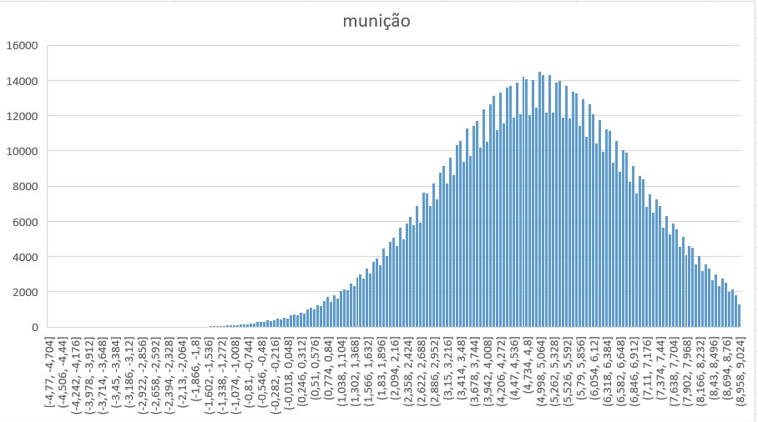
Munição por inimigo
->
Distribuição de Normal
µ=9
σ=2
F(x)=(1/2)[1+erf((x-u)/(o√2))]
F^(-1)(x)=u+o√2*erf^(-1)((erf((M-u)/(o√2))+erf((M-u)/(o√2)))U-erf((M-u)/(o√2))
double gaussianaInv(double med, double desv, double M)
{
double aux = SpecialFunctions.Erf(med / desv * Mathf.Sqrt(2));
double p = UnityEngine.Random.Range((0f), (1f));
return med + desv * Mathf.Sqrt(2) * SpecialFunctions.ErfInv((SpecialFunctions.Erf((M - med) / desv * Mathf.Sqrt(2)) + aux) * p - aux);
}

Slide 7
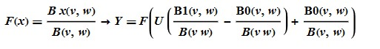
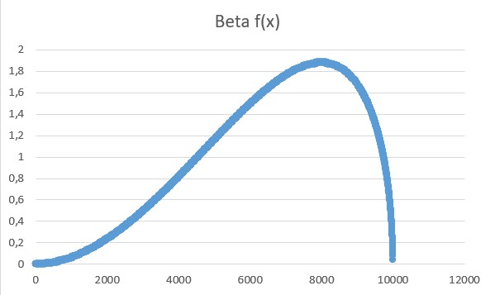
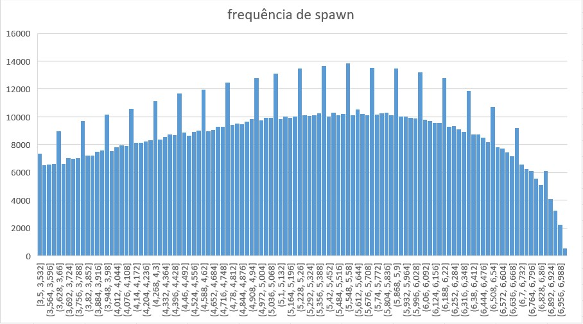
Frequência
-1
Distribuição Beta * 7
v=3
w=1,5
Truncada (Limite inferior = 0,5)
trunc[0.5,1], v=3,w=1.5 -> Y= F^(-1)(x)((F(a)+[F(b)-F(a)]U), U[0,1]
F(x)=Bx(v,w)/B(v,w)
Y= F^(-1)( (B0(v,w)/B(v,w))+[(B1(v,w)/B(vw))-(B0(v,w)/B(vw))]U)
Y=F^(-1)(0.2155553[1-0.2155553]U)

Slide 8
double betaInvTrunc(double v, double w, double a)
{
double funca = SpecialFunctions.BetaIncomplete(v, w, a) / SpecialFunctions.Beta(v, w);
double arg = funca + (1 - funca) * UnityEngine.Random.Range((0f), (1f));
return (betaInv(v, w, arg));
}
double betaInv(double v, double w, double x)
{ double lowerBound = 0.0;
double upperBound = 1.0;
double epsilon = 1e-6;
while (upperBound - lowerBound > epsilon)
{double middle = (lowerBound + upperBound) / 2;
double cdfValue = CDFBeta(v, w, middle);
if (cdfValue < x)
{lowerBound = middle;}
else{upperBound = middle;}
}
return (lowerBound + upperBound) / 2; }
double CDFBeta(double v, double w, double p)
{return SpecialFunctions.BetaIncomplete(v, w, p) / SpecialFunctions.Beta(v, w);
}

Slide 9
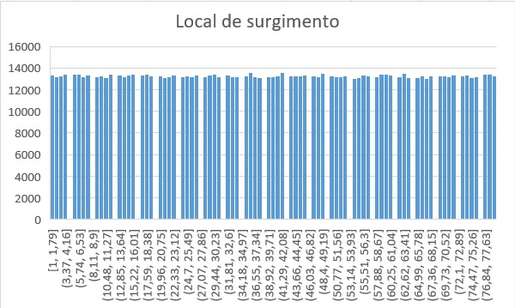
Local de surgimento
Distribuição uniforme [1,80]
double localSpawn()
{
return UnityEngine.Random.Range(1, 80);
}

Slide 10
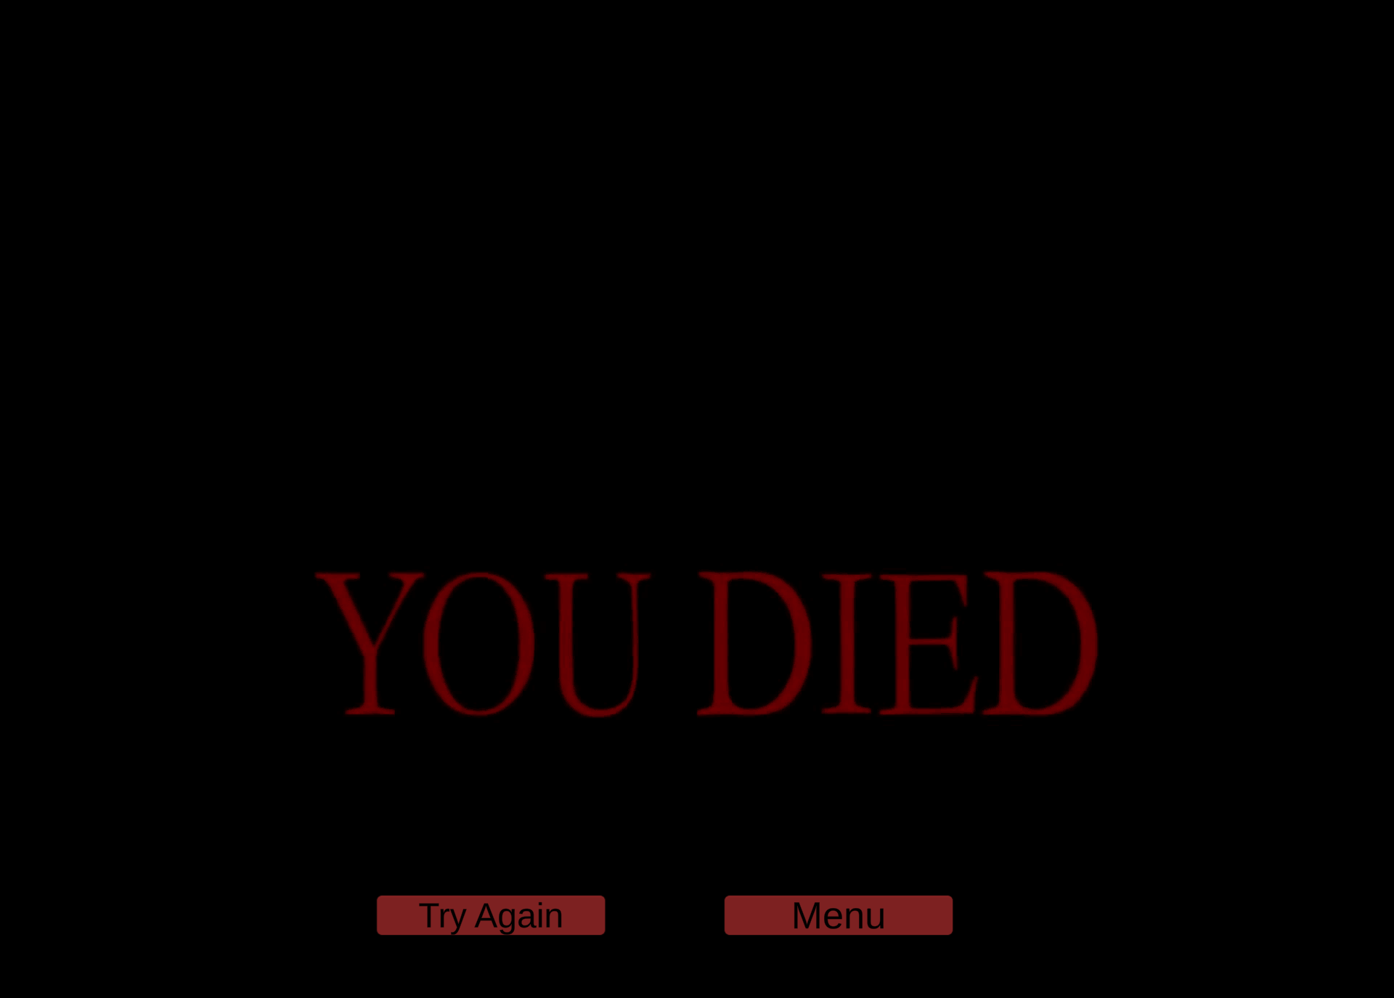

Slide 11
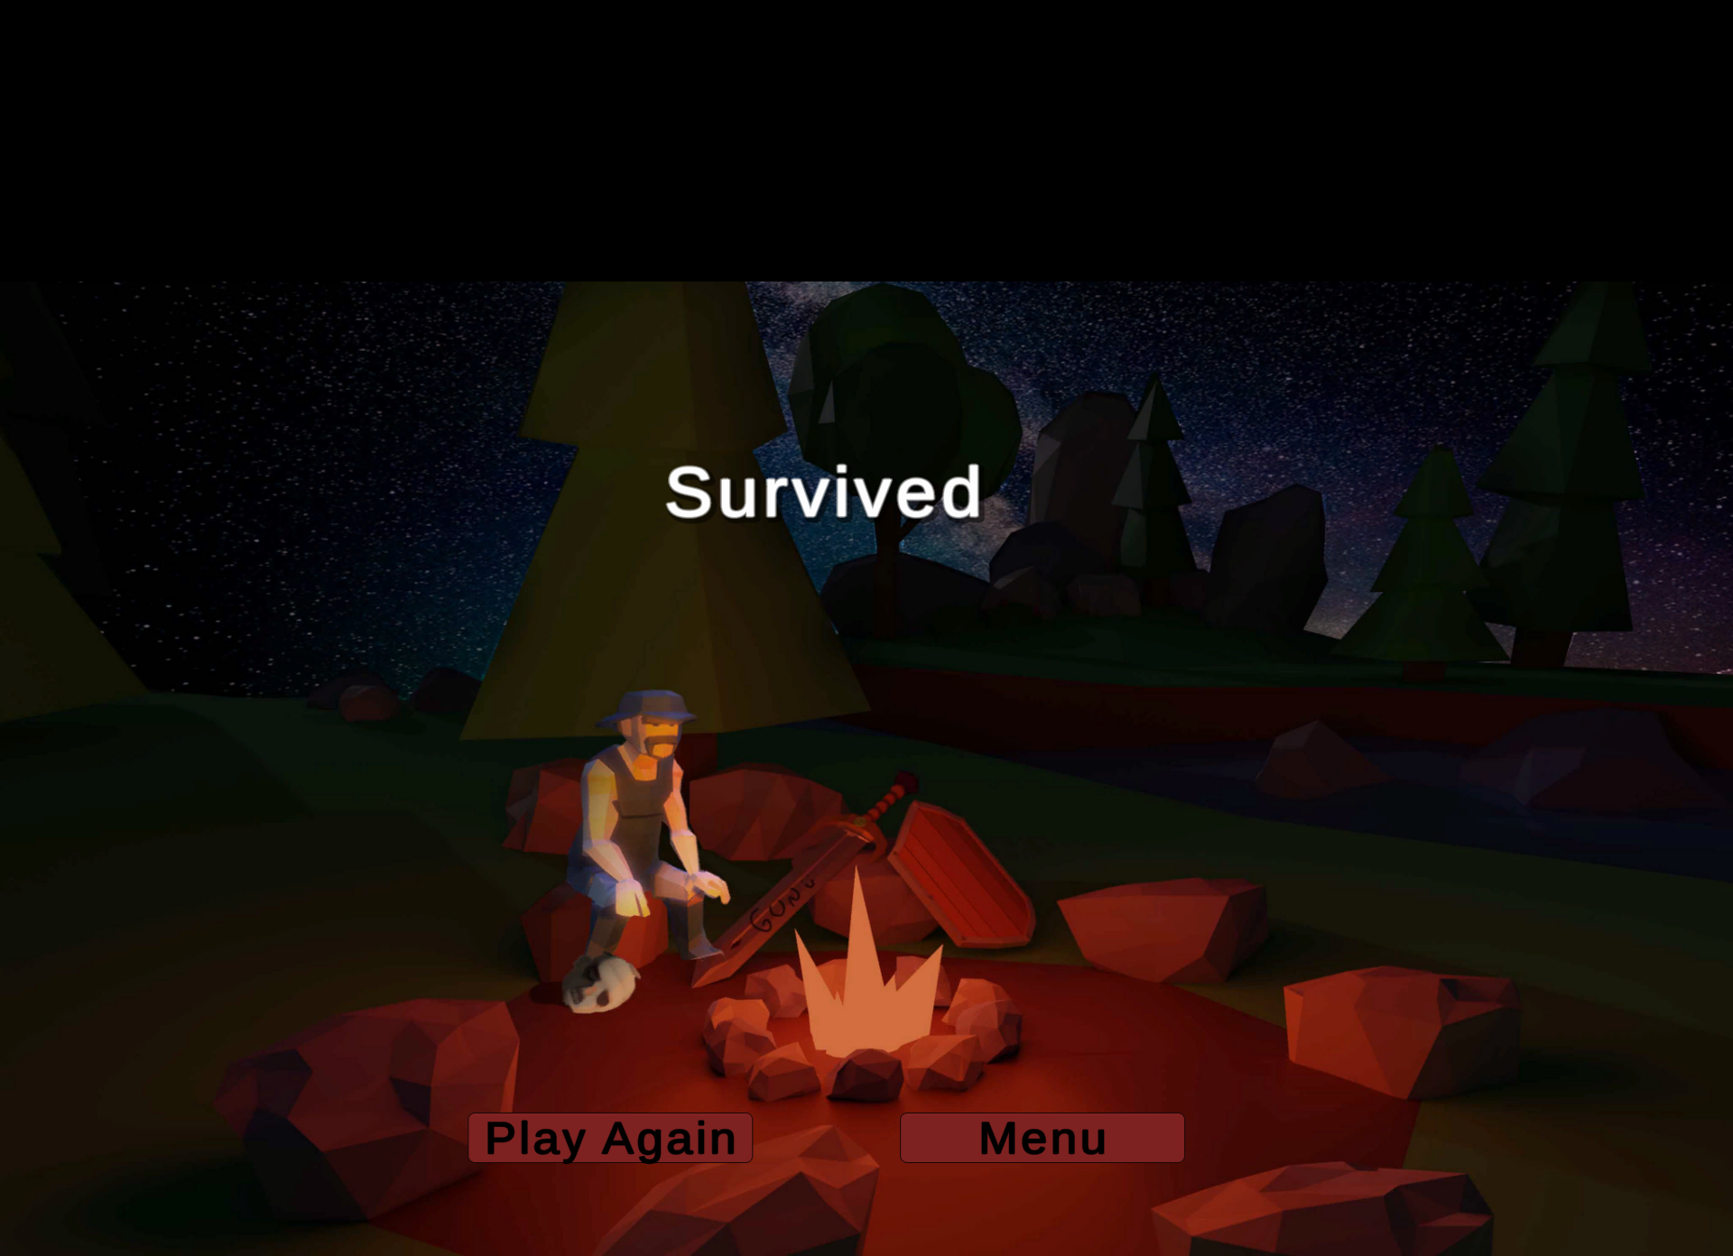

Slide 12
